Slide 1
See Singapore
Home
Sign Up
Sign In
All Attractions:
Singapore Botanic Garden
National Museum of Singapore
Notes:
HOME PAGE

Slide 2


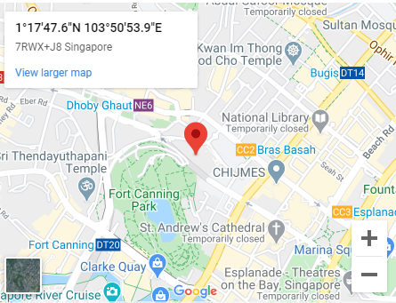
See Singapore
Home
Sign Up
Sign In
Logged in as Melody
Logout
Category
History
Address
93 Stamford Road, Singapore
178897
National Museum of Singapore
Rating
Recommended by 1 visitor
If you have time to visit only one place to learn about the history and culture of Singapore, this is probably it.
What do visitors say about this attraction?
Write a review
Directions
Notes:
PAGE FOR EACH ATTRACTION

Slide 3
See Singapore
Home
Sign Up
Sign In
Logged in as Melody
Logout
Review for National Museum of Singapore
Do you recommend this attraction?
Yes
v
Comments
Submit
Notes:
USER REVIEW SUBMISSION PAGE

Slide 4
See Singapore
Home
Sign Up
Sign In
Sign Up
Your name
Email address
name@example.com
Password
Sign Up
Notes:
SIGN UP PAGE

Slide 5
See Singapore
Home
Sign Up
Sign In
Thanks for signing up!
Go home
Notes:
SIGN UP SUCCESSFUL PAGE

Slide 6
See Singapore
Home
Sign Up
Sign In
Sign In
Email address
name@example.com
Password
Sign In
Notes:
SIGN IN PAGE

Slide 7
See Singapore
Home
Sign Up
Sign In
Sorry, login failed.
Go home
Notes:
SIGN IN FAILED PAGE

Slide 8
See Singapore
Home
Sign Up
Sign In
Welcome back! Thanks for signing in.
Go home
Notes:
SIGN IN SUCCESSFUL PAGE

Slide 9
See Singapore
Home
Sign Up
Sign In
You have successfully logged out.
Go home
Notes:
LOGOUT PAGE

